Slide 1
Section 2: Ridge & LASSO
TA:

Slide 2
Agenda
Review Regularization with Ridge and Lasso
Ed Notebook
Standard Scalar (documentation)
Ridge, Lasso code (documentation)
Notes:
Review Ridge, Lasso regularization

Slide 3
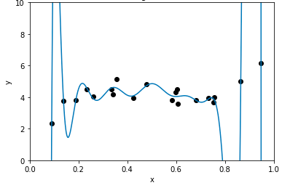
Regularization
Model self-regulates to prevent overfitting
Ensures coefficients are not “too large”
Notes:
What is regularization, at a high level this refers to a model that prevents overfitting and to do that we want to ensure that our coefficients of our model are not too large, we want to ensure that the coefficients fit every x, y data point that we train our model on

Slide 4
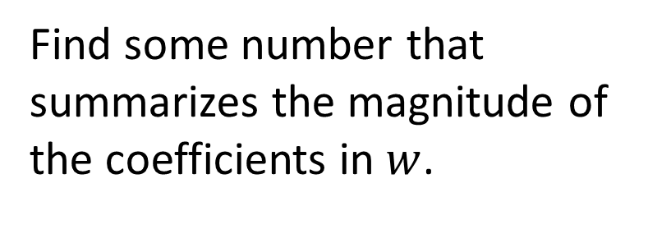
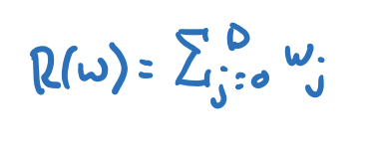
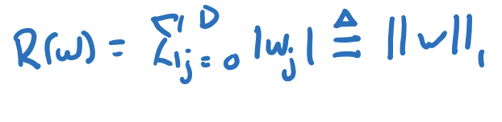
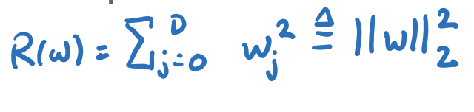
Regularization
Sum?
Sum of absolute values?
Sum of squares?
Notes:
So there a few different ways to regularize, the 1) way we talked about was the sum of the coefficients but we what we learned might be wrong with that is that say you have a really large positive coefficient and a really big negative coefficient, when you add those together we get a small sum so this isnt a really good regularization technique- this leads us to the two other techniques we talked about in class- the sum of absolute values also known as the L1 norm which we use in LASSO regularization and the sum of squares also known as the L2 norm used in Ridge Regularization

Slide 5
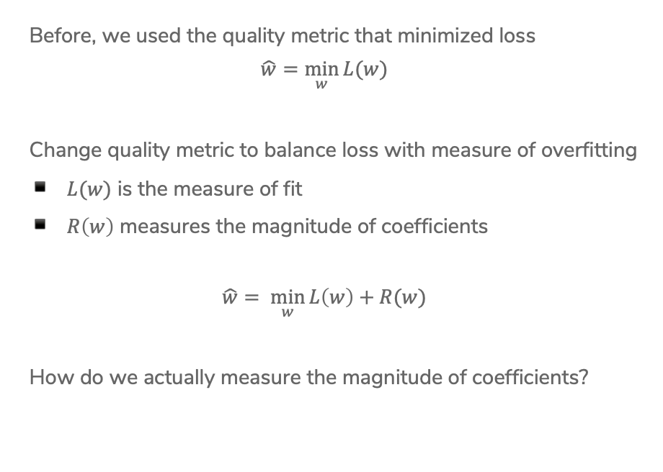
Recap: Regularization
Notes:
Draw: L(w) = RSS(w)

Slide 6
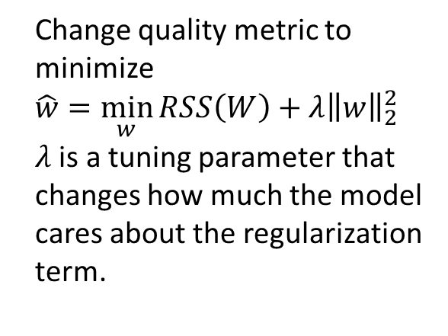



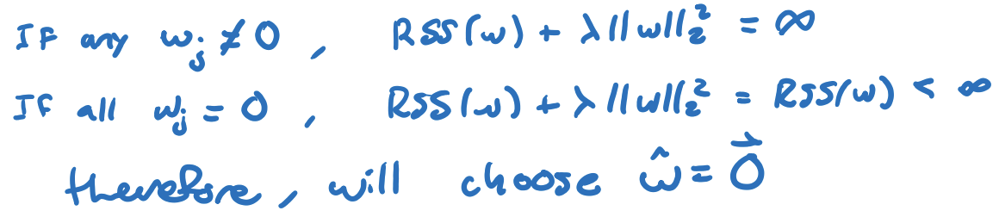

Ridge Regression
Notes:
So in Ridge regression we are minimizing our w hat equation where lambda is a hypertuning parameter that we have to set- so as recap what happens when we set lambda to be 0 -> this just leads us with minimizing the RSS value like in Linear Regression-> also note that this is often called ordinary least squares error so if you see OLS or LS it is referring to this, and so next what happens if lambda is infinity -> this forces our quality metric to become 0 and the reason because of that is we are trying to minimize our equation so any number resulted from our L2 norm that is not 0 will result in a really large number so then 0 is our minimum and lastly so our lambda must be inbetween 0 and the minimized RSS values

Slide 7
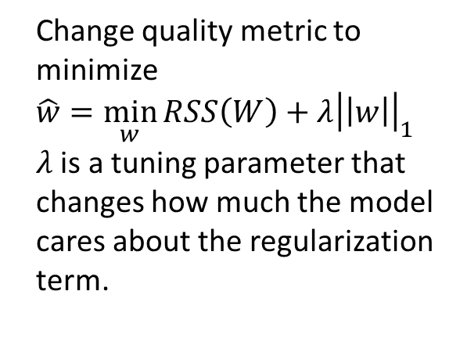


Lasso
Notes:
So now moving onto LASSO, this is kind of the same thing as Ridge but we are using the L1 norm which is the absolute sum and so again we get the same minimized values with lambda equalling 0 and infinity as in Ridge, however the difference is that if you remember from lecture applying these to feature selection will give us very different looking graphs when seeing what features it will choose- LASSO will most likely find features and set them 0 while having other features with greater values but Ridge will most likely minimize all value but never having all values quite reach 0 and that is because Ridge uses L2 norm which is squared so when you square something it will always get smaller but never reach 0 and for LASSO it’s not squared so you don’t get that property

Slide 8
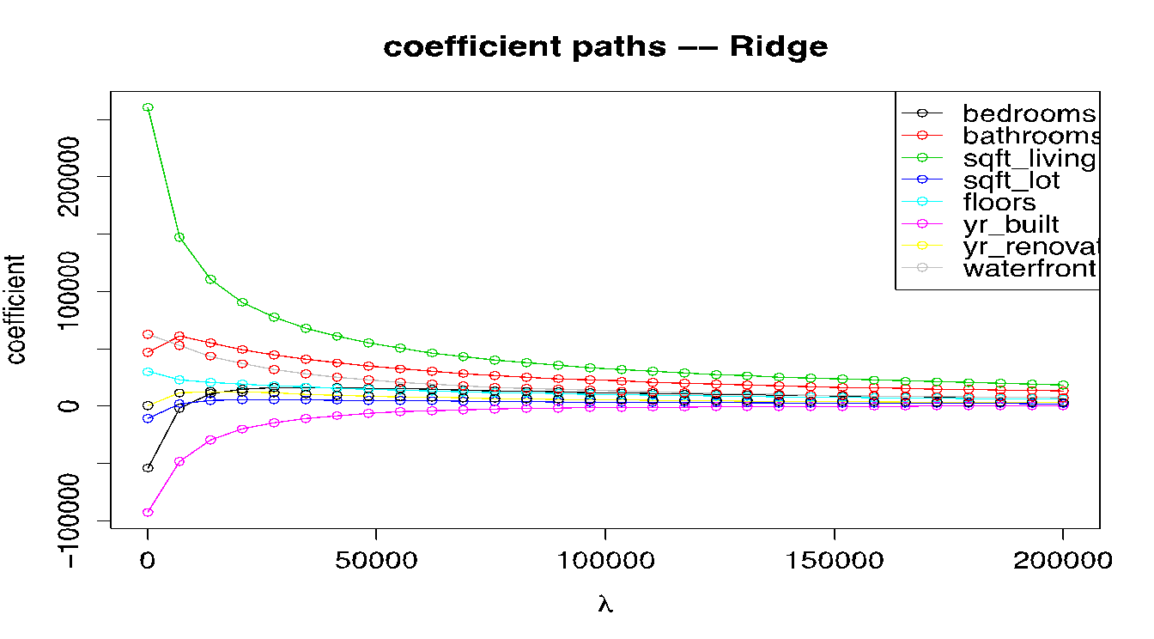
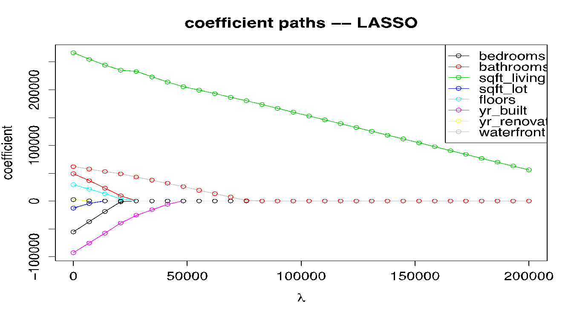
Comparison
Ridge Coefficient Paths
2) Train with best features
Lasso Coefficient Paths
1) Feature selection

Slide 9
Hyperparameters
How to tune hyperparameters?
for each setting of HPs:
train model with current HP
validate predictor (cross validation)
track HPs with lowest validation error
return best HP and estimate of test error
Notes:
Can you describe the algorithm?
How do we choose the right value of 𝜆? We want the one that will do best on future data. This means we want to minimize error on the validation set.
Here is just some quick psuedocode on how you would want to choose your hyperparameters, in other words lambda and so high level overview on how to do that, you will pick a lambda value and train you model with that HP and then get a prediction using the validation set- then you will save that value and at the end you want to use the model that had the lowest validation error and that’s how you can find the HP

Slide 10
Time for Python Demo
Links to the materials on Canvas

Slide 11
Closing Thoughts
Let me know if you have…
Questions (content or otherwise)
Feedback on how section is run
Cool ML research/applications you want to share (maybe we could incorporate it into the lesson plan!)

